Slide 1
Information System Project
Design and development of an UI for a Yoga Mat

Slide 2
AGENDA
Overview
Goals
Work Process
​Summary​

Slide 3
Overview
The aim of this project is to develop a smart sleep yoga mat to calculate heart rate and breath rate of a person when laying on the mat.
This system will be useful for people who do yoga but they don’t know the correct way to relax their body and mind.
This method of measuring heart rate and breath rate is comfortable for the person laying on the mat. The system is cheap and can be easily incorporated in traditional mat.

Slide 4
GOALS
→ Pressure mat matrix preparation
→ Model for posture from pressure mat

Slide 5
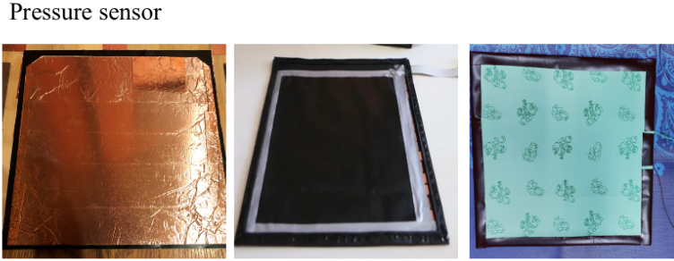
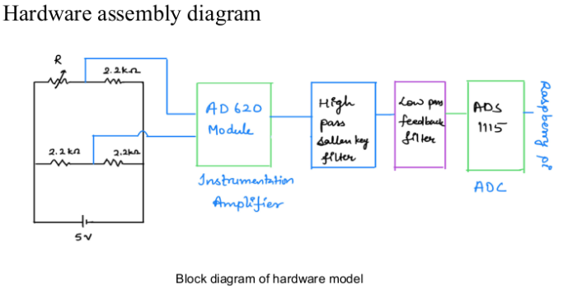
Pressure mat creation
Hardware Assembly

Slide 6
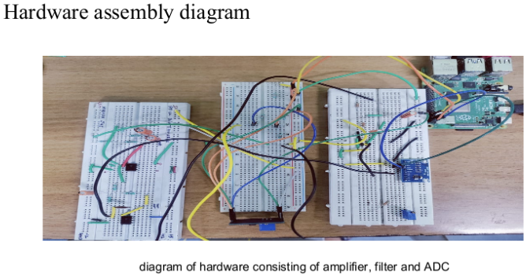
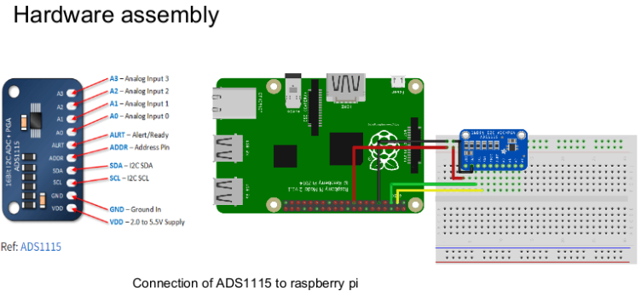

Slide 7
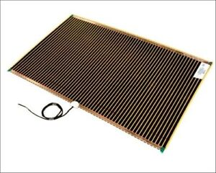
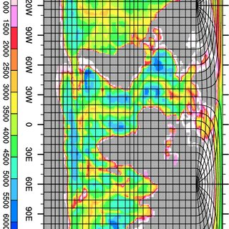
Pressure Mat matrix assembly

Slide 8
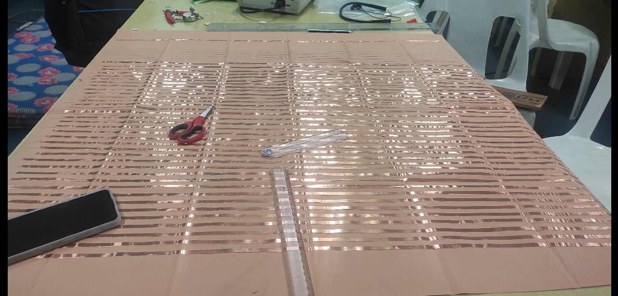
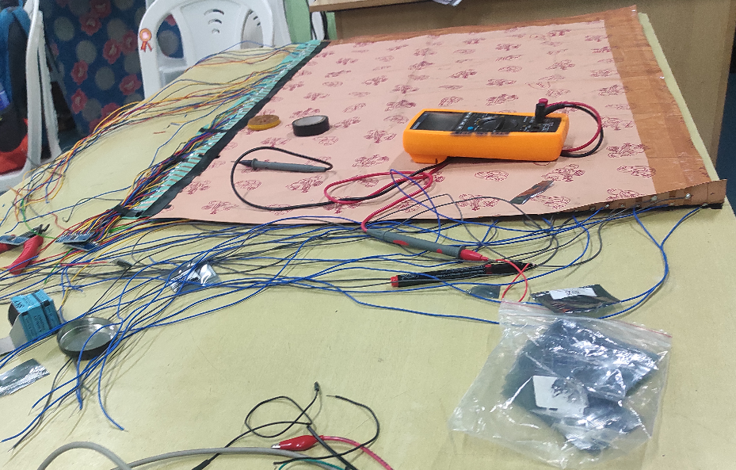
Pressure mat creation
To increase the efficiency of pressure mat we decide to make it matrix wise.
we make 56 row and 36 column with silicon tape which create 2016 pressure point in pressure mat

Slide 9
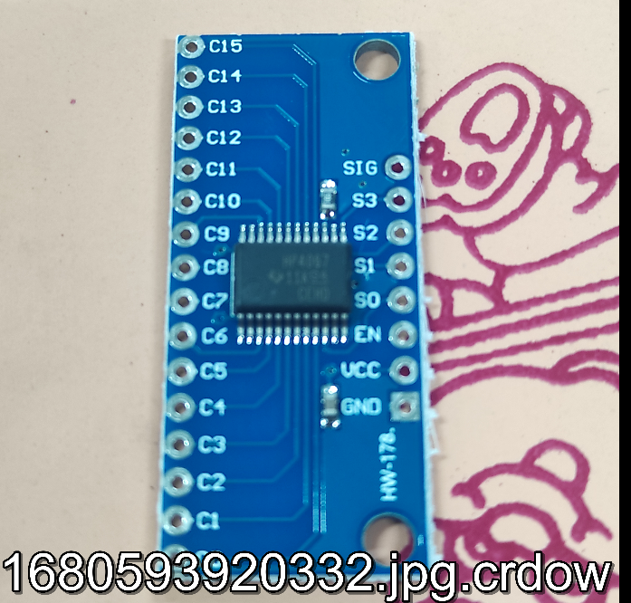
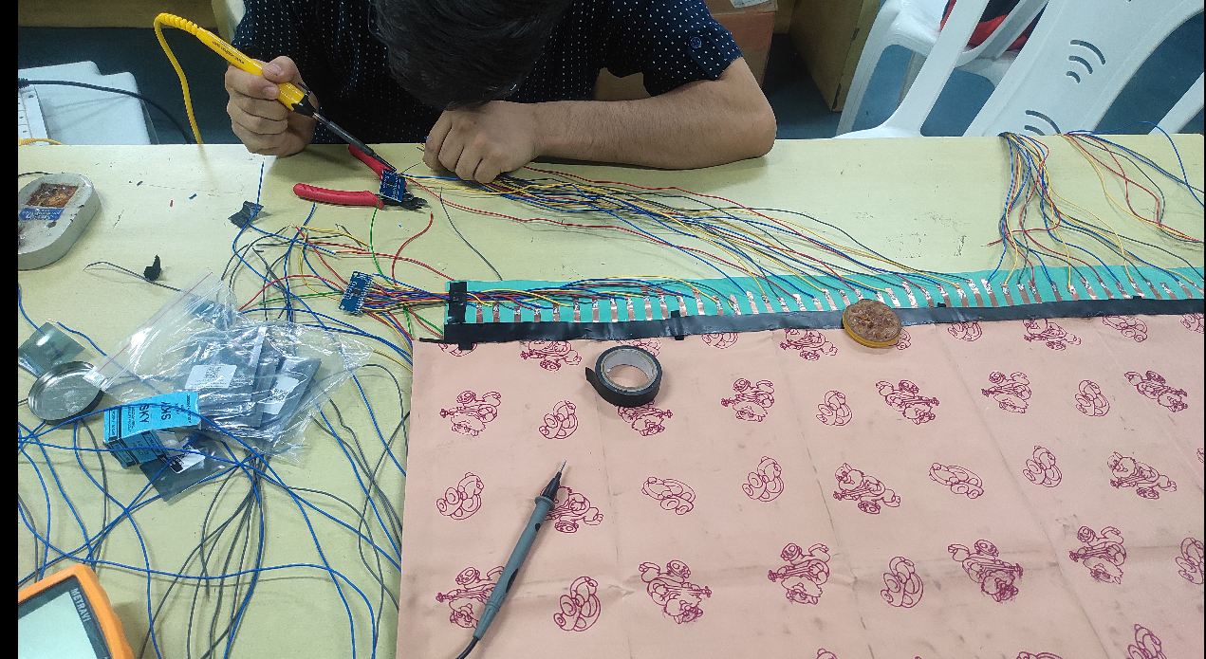
Pressure mat creation
We use 7 multiplexer to transfer digital data from pressure mat to raspberry pi.
We connect 4 multiplexer at row side which connect 56 wires and 3 multiplexer at column side which connect 36 wires.

Slide 10
Model for posture from pressure mat
To train a model first we need data set which we supposed to get from pressure mat but due to some problem in raspberry pi right now we are unable to get live data from pressure mat.
We using pre-existing pressure mat data to train our model.
link for the data →https://physionet.org/content/pmd/1.0.0/
The Pressure Map Dataset for In-bed Posture Classification database contains in-bed posture pressure data from multiple adult participants using pressure sensing mats.

Slide 11
Data collection and files specification
We collected in-bed posture pressure data from multiple adult participants using pressure sensing mat. To the best of our knowledge, our dataset, PmatData is the first publicly-available dataset of pressure sensor data which includes various sleeping postures. PmatData contains pressure data from experiments. These two experiment is
Experiment : Pressure data from 13 participants in 8 standard postures and 9 additional states.
Size of pressure mat is 32*64. This is the raw data collected reporting numbers in range of [0-1000] for each sensor.
Each file includes the data frames around 2-mins (around 120 frames).

Slide 12
Data collection and files specification
The data files are provided in tab delimited text format, listed in subdirectories named after the experiment number and subject number.
For experiment the text files are named after the position number from 1-17. Each file contains multiple frames of recordings, with the 2048 columns representing the 32x64 pressure sensor measurements, and each row giving a new set of samples.

Slide 13
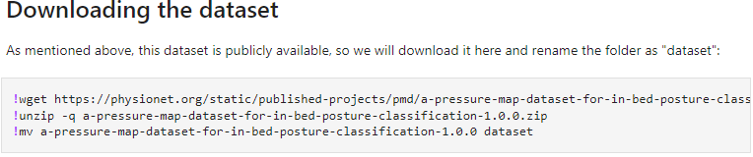
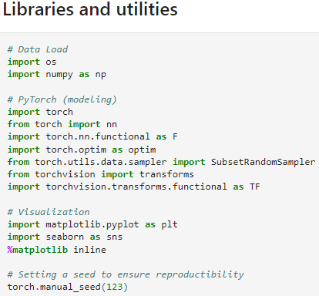
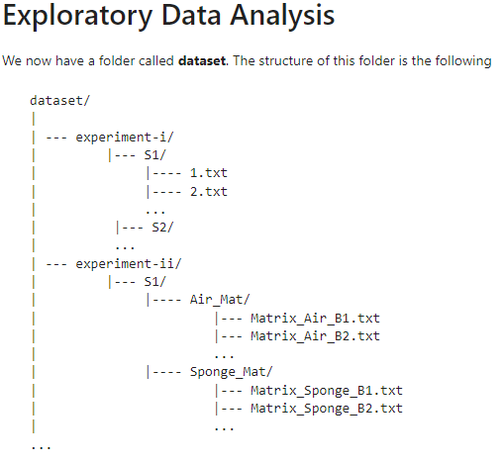
Model for posture from pressure mat
CODE LINK -

Slide 14
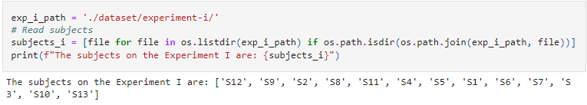
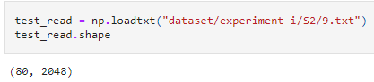
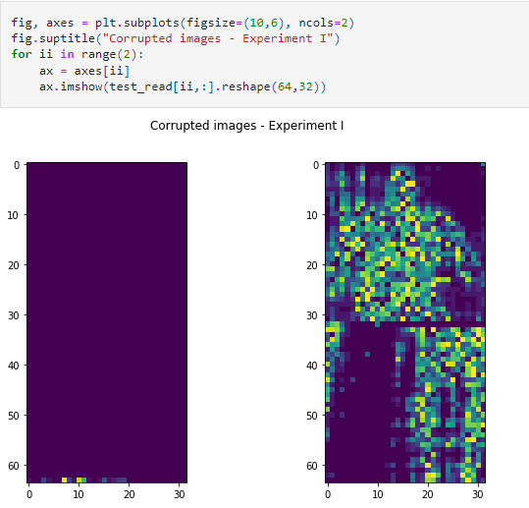
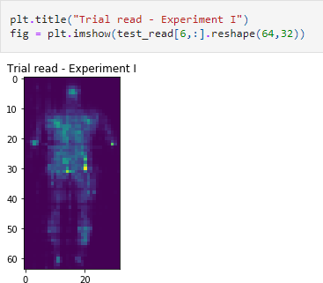
Experiment

Slide 15
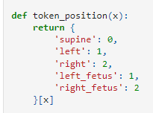
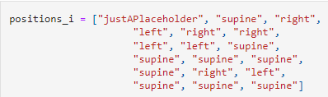
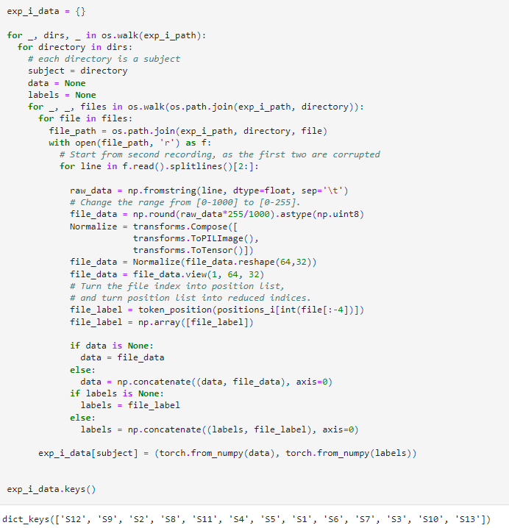
First we set a 'Position vector': We load the data with respect to the file name, which is a number corresponding to a specific in-bed position.
We also want the classes to be encoded as numbers so we can work easier when modeling. This function achieves so.
Now we will load the data into a dictionary, where the keys will be the subjects:

Slide 16
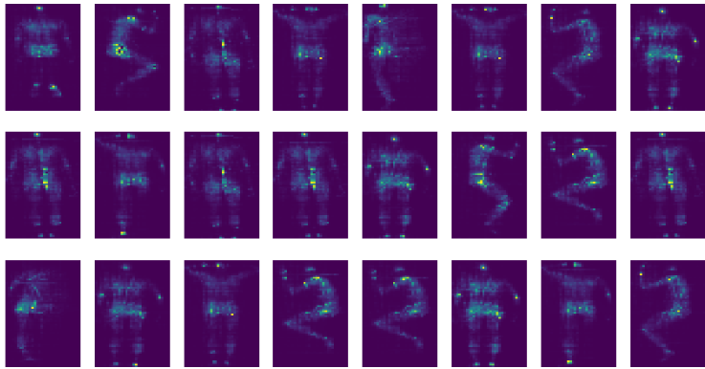
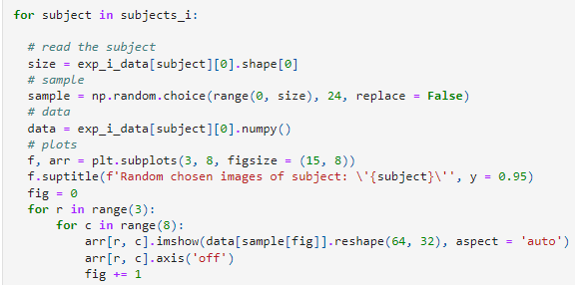
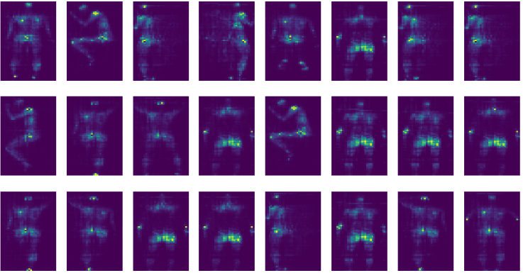
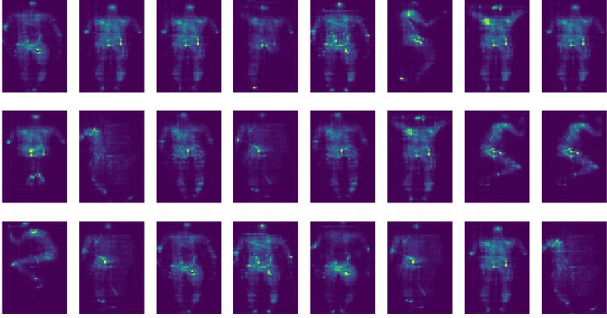
Data loading is a mandatory step in our further notebooks. To avoid code repetition, we created a helper.py file where we will store several of these processes as functions. The process of loading of the data for this experiment was defined as the function load_exp_i().
For this visualization, we plotted 24 images per subject:

Slide 17
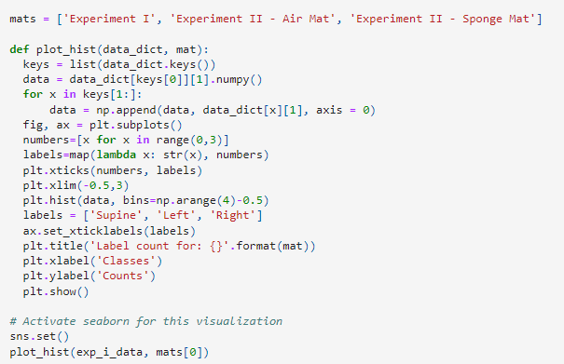
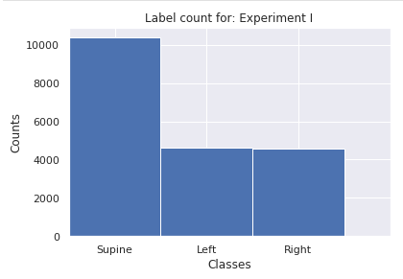
After observing the data, it seems that some samples have a degree of noise. This might be explained a transitional pressure recording when the person was moving from one position to the other. Even though there were 17 unique positions, one can visually inspect and separate them into the five common postures mention previously: left, right, left fetus, right fetus, and supine.
We decided to label the 'fetus' positions as the corresponding left/right positions.
We finally make a count of the number of available positions in the database

Slide 18
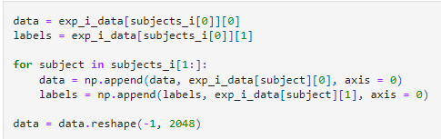
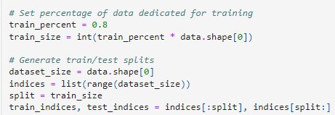
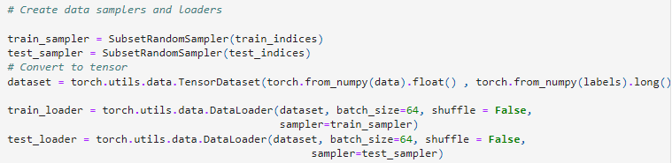
Training a Model using 'Experiment' data
After our exploration to the dataset, we want to create a shallow model to introduce the workflow on PyTorch when building a classification model using neural networks (NN). We use the only exp_i_data and reshape it into a flat representation to be used by the model. It is shallow in the sense that image classification is achieved with better results using convolutional neural networks (CNN).
We want to split the data randomly into a training and a testing set. However, we expect that the results will be overestimated, because the 'lying bed positions' scenario has low dynamics, meaning that a person remains on the same positions for several seconds and the measurements should not vary that much, meaning that most of the testing data will be similar to the training one.

Slide 19
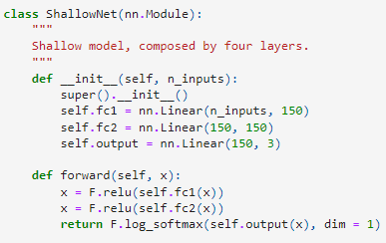
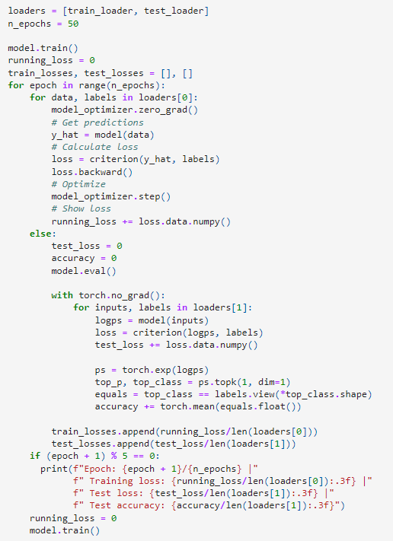
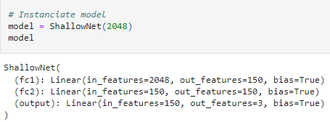
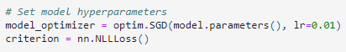
Model
Here we introduce the shallow model: a 3-layer NN that uses ReLU and Softmax as activation functions:
Training

Slide 20
THANK YOU
Dheeraj Gahlot
dhruvkgp2003@gmail.com

